Slide 1
Clinical Case discussion

Slide 2
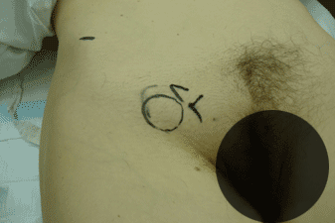
Clinical Case discussion
72-year-old woman presented to preliminary care unit (PCU) at NCTH Ragama with abdominal pain, nausea and vomiting since 5 days prior to admission.
On general physical examination, she appeared to be ill, with diffuse abdominal distention; mild generalized tenderness, there were no clinical signs of peritonitis.
On further focused physical examination revealed a lump at femoral region

Slide 3
Clinical Case discussion
Briefly describe the anatomy of femoral region?

Slide 4
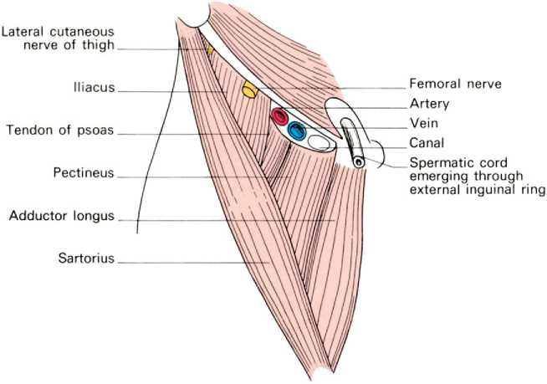
Clinical Case discussion
Briefly describe the anatomy of the femoral region?

Slide 5
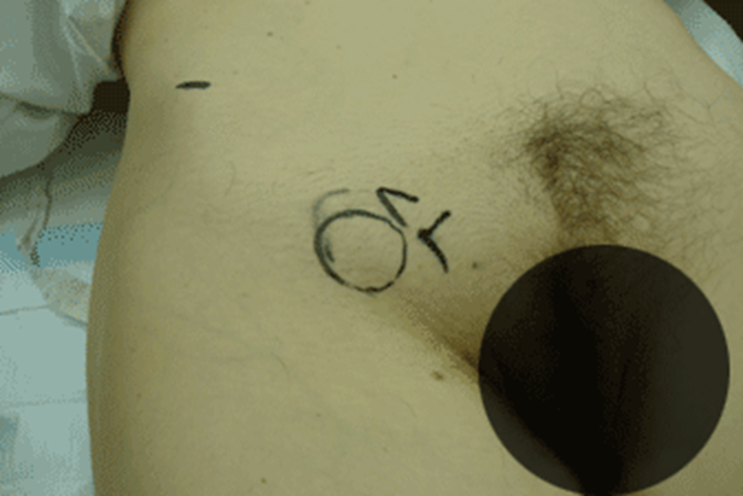
Clinical Case discussion
As a PCU surgeon , what are the differential diagnosis of this lump, based on the anatomy in that region ?

Slide 6
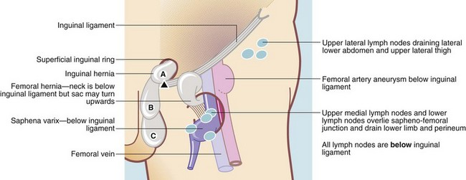
Clinical Case discussion
Differential diagnosis
Skin and soft tissue-Lipoma, Sebacious cyst, Sarcoma
Femoral Artery – Aneurysm
Femoral vein-Varix of saphenous vein (Disappears when lying flat, palpable thrill when coughing, presence of varicose veins elsewhere)

Slide 7
Clinical Case discussion
Differential diagnosis-
Femoral nerve –Neuroma of the femoral nerve
Femoral canal –Femoral hernia.
Psoas sheath- Psoas abscess
Lymph nodes- LN abscess or lymphadenopathy
Low presentation of inguinal hernia

Slide 8

Clinical Case discussion
What is the probable clinical diagnosis based on this case scenario ?

Slide 9
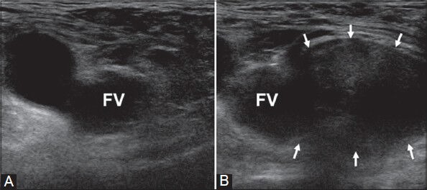
Clinical Case discussion
Urgent bedside Ultrasound scan was performed and confirmed the differential diagnosis as femoral hernia
Diagnosis is usually clinical
However gold standard is via ultrasound scan.
US scans are 96% accurate in identifying the specific type of hernia
But are operator dependent.

Slide 10
Clinical Case discussion
Describe the anatomy of femoral hernia?

Slide 11
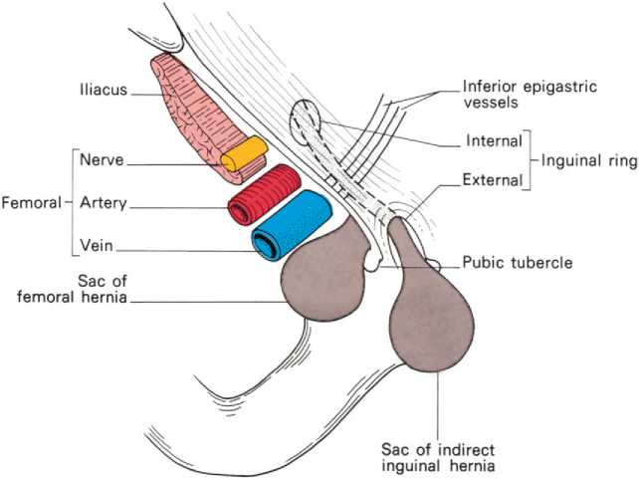
Clinical Case discussion
A femoral hernia is the protrusion of a peritoneal sac through the femoral ring into the femoral canal, posterior and inferior to the inguinal ligament.
The sac may contain preperitoneal fat, omentum, small bowel, or other structures.
Femoral hernia – found infero-lateral to the pubic tubercle (and medial to the femoral pulse)
Inguinal hernia – found superomedial to the pubic tubercle

Slide 12
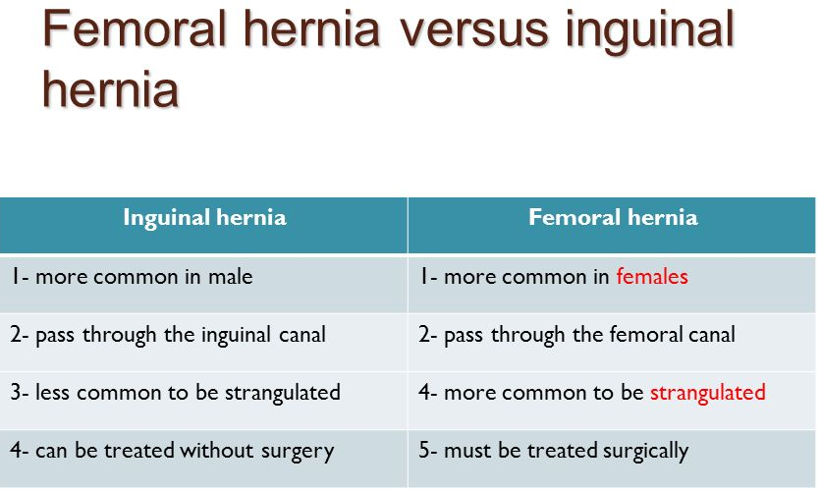
Clinical Case discussion

Slide 13
Clinical Case discussion
Why femoral hernia liable to obstruct than inguinal hernia?

Slide 14
Clinical Case discussion
Femoral hernias account for a fifth of all groin hernias in females but less than 1% of groin hernias in males
Why it is relatively common in females?

Slide 15
Clinical Case discussion
Wheat are the possible complications of obstructed femoral hernia ?

